Slide 1
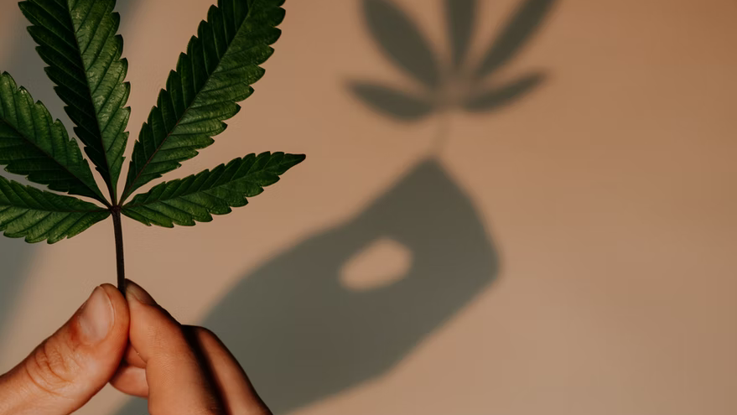
Cannabis: Internationally & Domestically
Cannabis Practice Group
February 22, 2022

Slide 2
Cannabis Practice Group & Presenters
Eric Sleeper
Partner, Barton LLP
Carrie Ward
Attorney, Earp Cohn P.C.
Alexandra Becker
Partner, Nolan Heller Kauffman LLP
Michelle Mabugat
Counsel, Greenberg Glusker Fields Claman & Machtinger LLP

Slide 3
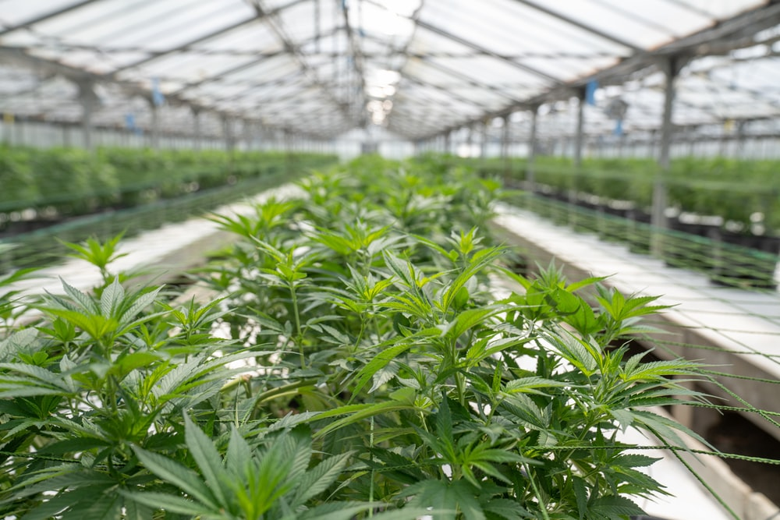
Why a Cannabis Practice Group?
Huge commercial growth in less than a decade
Worldwide sales of legalized marijuana alone topped $21 billion in 2020; projections show market growth rising above $100 billion by 2028
There has been an equally rapid growth of cannabis ancillary businesses and accessory products, including those infused with CBD, CBG, and/or CBN or developed through the cultivation of hemp with its ever increasing commercial and industrial uses
A very broad-based industry:
Plant-touching cannabis businesses –
Cultivators
Lab Testers
Manufacturers
Distributors
Retailers/Dispensaries
Delivery Services
On-Site Cannabis Consumption Lounges

Slide 4
Why a Cannabis Practice Group? (cont’d)
Non-touch ancillary/accessory businesses – numerous and growing annually; don’t face the licensing and regulatory hurdles of plant-touching companies; but offer the types of products and services that both cannabis and non-cannabis businesses and everyday people engage with regularly
Environmental
Construction
Packaging
Security
Marketing
Technology
Numerous Accessory Products
Infused Products (CBD, CBG, CBN)
Hemp-Based Products
Psychedelics

Slide 5
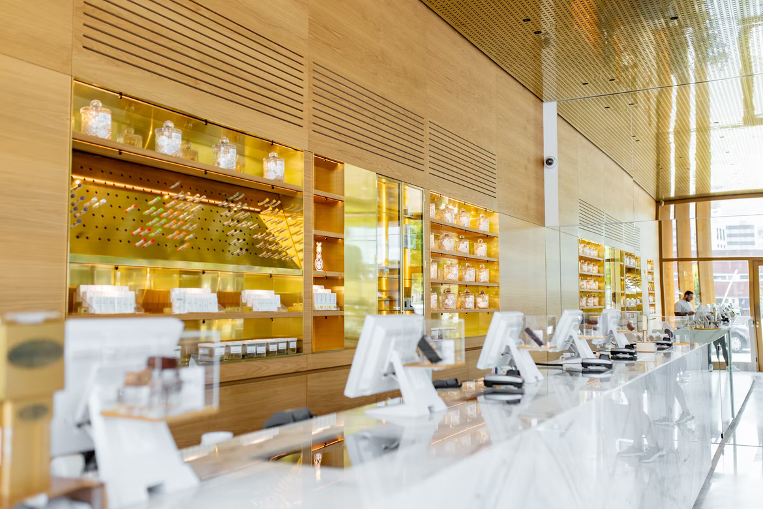
Diverse, Multi-Disciplinary Legal Services
Corporate
Corporate formation and structure
Public companies and SEC and other agency filings
Capital formation activities
Mergers and acquisitions
Partnership and operating agreements
Domestic and cross-border financing and merger and acquisition transactions

Slide 6
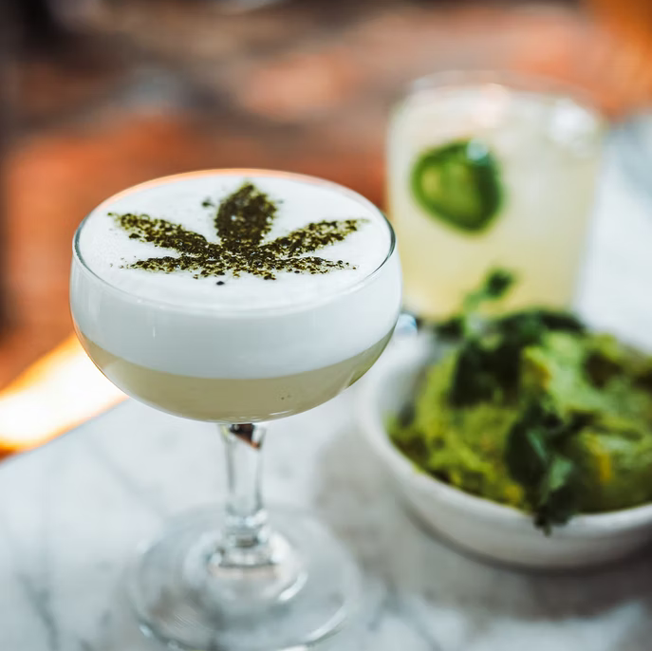
Diverse, Multi-Disciplinary Legal Services (cont’d)
Litigation
Civil matters, such as breach of commercial contracts or fraud/ misrepresentation
Products liability/manufacturing defects
Trademark and patent infringement
Employment-related claims

Slide 7
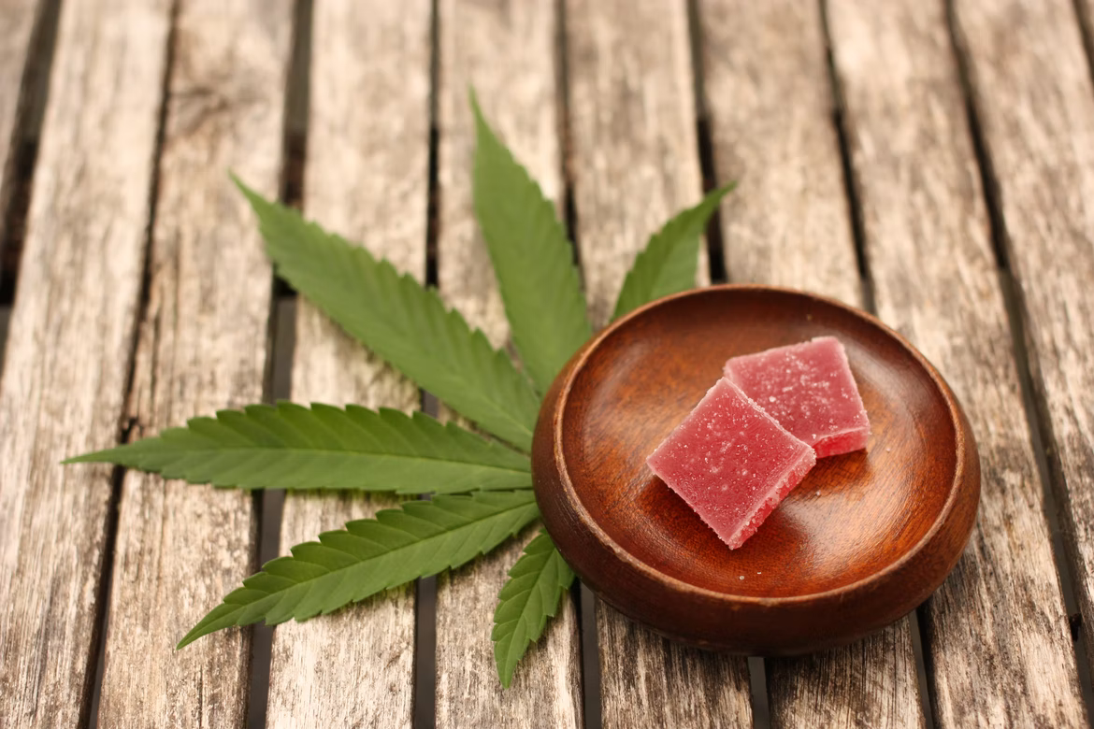
Diverse, Multi-Disciplinary Legal Services (cont’d)
Taxation
General planning and advice
IRS Section 280E
Real Estate and Construction
Zoning and land use
Leasing and landlord/tenant matters
Intellectual Property
Trademarks and patents
Licensing agreements
Marketing and branding
Health Law
Hospital compliance; HIPAA
Labor and Employment
Workplace training
Non-compete
Executive employment agreements
Insurance
Cybersecurity
Financial Restructuring and Bankruptcy
Information Technology and Management Software
Environmental Considerations

Slide 8
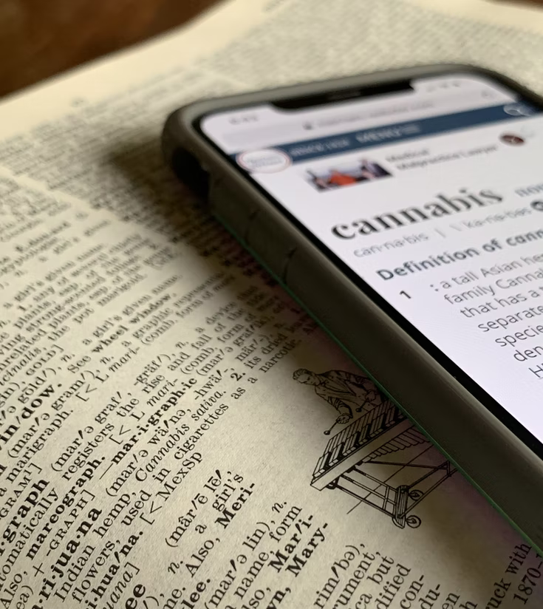
What Is Cannabis?
A plant, obviously (though some refer to it as a “weed”). It’s existence dates back to the prehistoric era. It was first domesticated about 12,000 years ago in East Asia.
Like most plants, it is composed of roots, a stem (stalk), branches, leaves, and buds or flowers. The bud/flower is the primary source of active ingredients used to make medical marijuana and adult recreational cannabis products. The other principal user component of the cannabis plant is its stalk whose fibers, known as hemp, are used to make, among other things, paper, fabric, rope, construction materials and oil.
Another notable component of the plant are its “trichomes.” These trichomes contain a great deal of the “cannabinoids,” such as THC and CBD, produced by the cannabis plant. The larger the number of trichomes, the higher the level of cannabinoids. The trichomes also contain “terpenes” (aromatic molecules) that carry the aroma of the plant which assist in product selection via aroma and flavor.

Slide 9
Some of the More Notable of the100+ Cannabinoids from Cannabis Are:
Tetrahydrocannabinol (THC) is the psychoactive chemical compound in cannabis that creates the high. It can affect thinking, memory, pleasure, physical movement, concentration, coordination, and sensory and time perception.
Cannabidiol (CBD) is mostly associated with cannabis’ potential health benefits. CBD is often used by patients seeking relief from pain, inflammation, anxiety, and seizures. It’s not psychoactive. CBD can also be extracted from hemp, and in this form, it’s federally legal; hence, hemp-derived CBD products are generally more available across the U.S.
Cannabigerol (CBG) is a non-psychoactive cannabinoid. It has analgesic, muscle relaxant, anti-erythemic (reduces redness in skin), antifungal, anti-depressant, anti-proliferative, anti-psoriatic, and anti-bacterial properties.
Cannabinol (CBN) is a mildly psychotic cannabinoid that comes from the degradation of THC after an extended period of time. CBN has analgesic, antibacterial, anti-inflammatory, anti-insomnia, antiemetic, appetite stimulant, and bone stimulant properties.

Slide 10
Types of Products Generated from Cannabis Include:
Fresh or dry herbal material (flowers/leaves) for smoking/vaping
Cannabis oil (cannabis extract dissolved in oil) which can be used in a variety of ways, including infusing edibles
Chemically concentrated extracts with heavy doses of cannabis extract dissolved in solvent
Physically concentrated extracts (e.g., hash/kief) such as pressed in resin
Edibles as food or drinks containing cannabis extracts
Tinctures/sprays composed of cannabis extract dissolved in a solvent
Sublinguals dissolvable under the tongue
Creams/salves/liniments using cannabis extract
Cosmetics enhanced with a cannabinoid like CBD

Slide 11
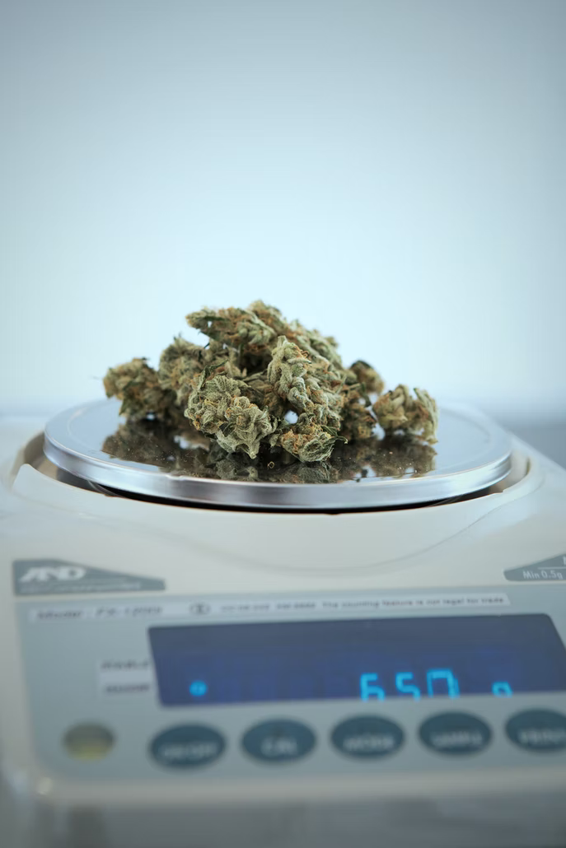
Legality in the United States
The cannabis plant has a history of medicinal/therapeutic as well as religious use dating back thousands of years among many cultures.
In the United States, however, increased restrictions and the labeling of it as a poison began in many states in the early 1900s. Outright prohibitions started to begin shortly thereafter. By the mid-1930s, all states regulated cannabis as a drug, including more than 30 that adopted the Uniform State Narcotic Drug Act. The first national regulation was the Marihuana Tax Act of 1937.
With the passage of the 1970 Controlled Substance Act (CSA), which among a number of other things, listed cannabis as a Schedule 1 controlled substance, cannabis was federally outlawed for any use, including medicinal. Criminalization and the “war on drugs” were also significantly enhanced.
Despite the ongoing designation of cannabis (non-hemp) as an illegal Schedule1 drug at the federal level, beginning approximately in 1996 with the passage of California’s Proposition 215 (California’s Compassionate Use Act permitting the use of medical cannabis) states and other jurisdictions have continued to pass and implement policies conflicting with federal law. By 2018, a majority of states had legalized medical cannabis. Also, beginning in 2012, the states of Colorado and Washington legalized the recreational use of marijuana and currently more than a third of the states have followed suit.
The Hemp Farming Act of 2018, at the federal level, also removed hemp (defined as cannabis with less than 0.3% THC) as a Schedule 1 controlled substance and made it an ordinary agricultural commodity.

Slide 12
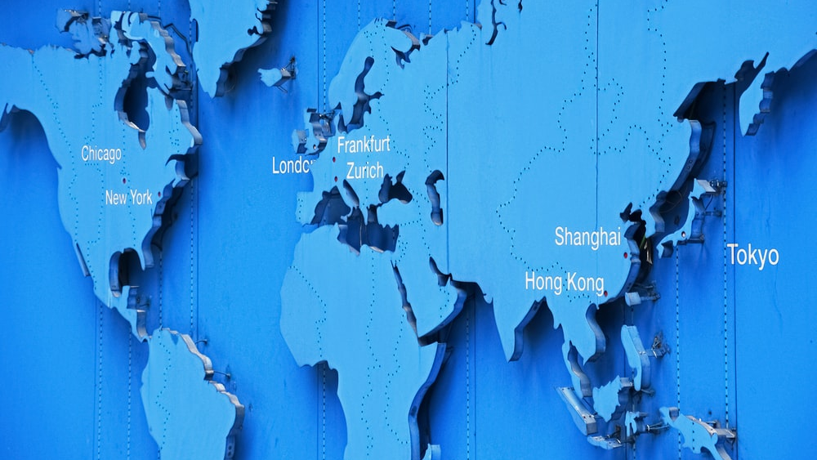
Cannabis Internationally
Have to be careful to not generalize the international market for cannabis and the status of its legality country to country.
The legality of cannabis for medical and recreational use, CBD and its infusion into edibles, and hemp and hemp products varies by country, in terms of possession, cultivation, distribution, and consumption (from a medical standpoint and what medical conditions it can be useful for). Cannabis, in general, is highly regulated worldwide.
A review of a majority of countries does lead to one notable generalization and that is how they treat cannabis for medicinal and recreational use. The differing approaches can be generally summarized as follows:
Illegal for all purposes including both medical and recreational (particularly in most Asian countries, a number of African countries, and most Middle Eastern countries, with the exception of Israel)
Decriminalized recreationally and legal medically (such as Argentina, Australia, Brazil, Uruguay, Mexico [with various limitations], Colombia, Israel, Luxembourg, Peru, Portugal, South Africa, Spain, and Switzerland)
Legal recreationally and medically (Canada, the Netherlands, Malta, a notable number of states in, or territories of, the United States)
Various of the countries in the European Union, particularly Germany and Italy, have legalized cannabis use medicinally and have indicated the possibility of moving towards legalized recreational use too. The United Kingdom, Ireland, and France allow medical cannabis use but not recreational.

Slide 13
Cannabis Internationally (cont’d)
A number of countries allow hemp cultivation and hemp-based products with little or negligible THC. Hemp cultivation increased almost 60% in European Union countries from 2015 to 2019 growing from 95,000 tons to 150,000 tons, with France generating more than 70% of that production.
Internationally, the manufacture and sale of consumer products with CBD has also been much more accepted with the exception of:
Infused edibles
Products making unsubstantiated medical or therapeutic claims
The policies in most countries are regulated by three United Nations treatises:
The 1961 Single Convention on Narcotic Drugs
Has been used as the basis for the standardization of national drug-control laws (incl. the CSA in the U.S.)
Categorizes cannabis as a Schedule 1 drug
But also affirms repeatedly the importance of medical use of controlled substances
The 1971 Convention on Psychotropic Substances
Designed to control psychoactive drugs like amphetamine stimulants, barbiturates, and psychedelics
The 1988 Convention Against Illicit Traffic in Narcotic Drugs and Psychotropic Substances
Drafted in attempt to provide greater enforcement against illegal drug trafficking, especially through organized crime, as part of the “war on drugs”

Slide 14
Cannabis Internationally (cont’d)
Even with the European Union driving principals of free movement of goods among the EU countries and the development of a single EU market, there is no one European cannabis market. There are few, if any, uniform sets of laws or regulations concerning cannabis by and between the EU member states. Instead, the cannabis market, and the corresponding regulations and criminal laws, vary from member state to member state. That applies to the three primary cannabis markets:
Medical use
Recreational use
Consumer health (especially CBD products)
Most cannabis-friendly EU countries: Netherlands, Luxembourg, Malta
EU countries becoming friendlier: Germany and Italy
EU countries decriminalizing (or lax enforcement of) personal use and legalizing medical use: Czech Republic, Estonia, Finland, France, Poland, Portugal, Slovenia, and Spain
Other international countries cannabis-friendly (to varying degrees); Canada Australia, Argentina, Chile, Colombia, Croatia, Ecuador, Georgia, Israel, Jamaica, Mexico, Morocco, Norway, Peru, Poland, South Africa, Switzerland, United Kingdom, and Uruguay

Slide 15
Cannabis in Canada
The Cannabis Act and its supporting regulations became effective October 17, 2018. Edibles, extracts, and topicals are all subject to a separate set of regulations.
Federal, provincial and territorial governments share responsibility for overseeing the cannabis regulation system. Health Canada is the primary regulatory body at the Federal level, however, some licensees (cultivators and processors) are also required to obtain licenses from the Canada Revenue Agency.
The Federal government's responsibilities are to set strict requirements for producers who grow and manufacture cannabis, as well as industry-wide rules and standards, including:
types of cannabis products available for sale
packaging and labelling requirements for products
standardized serving sizes and potency
prohibitions on the use of certain ingredients
good production practices
tracking requirements of cannabis from seed to sale to keep it out of the illegal market
restrictions on promotional activities.
Provinces and territories are responsible for developing, implementing, maintaining and enforcing systems to oversee the distribution and sale of cannabis. They are also able to add their own safety measures, such as:
increasing the minimum age in their province or territory (but not lowering it)
lowering the personal possession limit in their jurisdiction
creating additional rules for growing cannabis at home, such as lowering the number of plants per residence
restricting where adults can consume cannabis, such as in public or in vehicles.

Slide 16
California
1996: California became the first state to allow medicinal cannabis use when voters passed the Compassionate Use Act of 1996, also referred to as Prop 215.
2016: Voters passed Prop 64, the Adult Use of Marijuana Act (“AUMA”) which:
allowed adults 21+ to possess up to one ounce of cannabis and cultivate up to 6 plants for personal use,
gave the state the ability to regulate and tax the production, manufacture, and sale of cannabis for adult use,
amended criminal penalties.
2017: AUMA was substantially revised with the Medicinal and Adult Use Cannabis Regulation and Safety Act (“MAUCRSA”). MAUCRSA established the licensing regime and regulatory framework for cannabis operators. MAUCRSA gave three separate agencies regulatory powers - the Bureau of Cannabis Control, Department of Public Health, and Department of Food and Agriculture. These have since been consolidated – the primary regulatory body is now the Department of Cannabis Control.
Note: California operates on a dual licensing system. All operators must first obtain local approval before applying for State licensure. Most local jurisdictions have some sort of social equity component that aims to rectify issues created by the War on Drugs.
2018: The recreational market officially opened for consumers.

Slide 17
Oregon
The Oregon Legalized Marijuana Initiative, or Measure 91, was approved in 2014. The Measure legalized recreational cannabis and tasked the Oregon Liquor Control Commission (now called the Oregon Liquor and Cannabis Commission) with regulating cannabis activities. Measure 91 is also referred to as the Control, Regulation, and Taxation of Marijuana and Industrial Hemp Act of 2014. Recreational sales became legal in October 2015.
There are 6 types of recreational cannabis licenses offered by the State of Oregon: producer (cultivation), laboratory, research, processor (manufacturing), wholesaler (distribution), and retailer. Additionally, each employee of a licensee must obtain a worker permit.
Similar to California, Oregon law allows cities and counties to prohibit cannabis activity in their jurisdiction and local approval by way of a formal Land Use Certificate is required for State licensure. The vast majority of Oregon localities allow for cannabis activity.
In 2019, the State’s legislature voted 18-10 to freeze cannabis production licenses (while allowing existing licensees the ability to renew). The moratorium was set to expire this year, however, the legislature is exploring extending this moratorium to 2024 by way of HB 4016. The bill is controversial in that it would allow the regulatory body to inactivate applications submitted on or after January 2, 2022, creating serious financial consequences for applicants.

Slide 18
Washington
1998: Washington State legalized medical use in November when voters approved Initiative 692, providing immunity to patients.
2012: Recreational cannabis became legal with the passing of Initiative 502. Initiative 502 grants the Washington State Liquor and Cannabis Board regulatory powers.
2014: Recreational cannabis sales became legal in July.
Washington has 3 separate tiers for licensees: producers, processors and retailers.
Despite its status as a pioneer state in the cannabis space, Washington operators and applicants face three significant challenges:
The law does not allow for vertical integration. While a licensee may hold both producer and processor licenses, the initiative does not allow those licensees to also hold a retail license.
Washington differs from other West Coast states in its highly restrictive residency requirement. Under Washington law, all applicants (including members, governors, or agents of business entities) must have resided in the state for at least six months prior to application. This has proven to make securing capital difficult for operators and potential applicants.
While California’s cannabis industry is often regarded as the most over-taxed, Washington actually has the highest excise and sales taxes at 37% and 46.2%, respectively.

Slide 19
Arizona
2010: Medical use of cannabis is legalized when Arizona voters approve Proposition 203 with 50.15%. This is the third attempt at medical legalization – the first was in 1996 and the second in 2002.
2020: Recreational cannabis is legalized with the passage of Prop 207, or the Smart and Safe Arizona Act. The state had what is perhaps the most efficient rollout of its licensing structure with operators coming to market in 2.5 months. This was the second attempt at recreational legalization, after the first narrowly failed with 48.7% of the vote in 2016.
Arizona cannabis policy highlights:
Licensing Structure
Unlike some of the other West Coast states, AZ has a vertical integration requirement.
Limited licenses – the bill that legalized medical use capped dispensaries based on the number of pharmacies in the state (1 dispensary for every 10 pharmacies) for a total of 130 licenses. 26 are set aside for social equity applicants.
The law allows for licensees to sublease space in cultivation and manufacturing facilities.
Taxation
Consumers of recreational cannabis are required to pay an excise tax of 16% on top of normal sales tax. Medical consumers are not subject to the excise tax. Operators are also responsible for the transaction privilege tax. Taxes go toward community colleges, law enforcements, public health and criminal justice programs.

Slide 20
New York State Cannabis Law

Slide 21
Marijuana Regulation and Taxation Act (“MRTA”)
Signed into law on March 31, 2021, by then Governor Andrew Cuomo
Legalized adult-use cannabis with the stated goal of generating significant new revenue and promoting social justice
Created the Office of Cannabis Management and Cannabis Control Board
Cannabis Control Board will draft the rules and regulations that will implement the MRTA
Chair is Tremaine Wright
Office of Cannabis Management will administer the rules and regulations, issuance of licenses, etc.
Notes:
The Cannabis Control Board is within the Division of Alcoholic Beverage Control.
The Board will have five members: a chairperson and two more members appointed by the Governor; a member appointed by the Temporary President of the Senate; and a member appointed by the Speaker of the Assembly.
The Executive Director of the Office of Cannabis Management is appointed by the Governor, with the advice and consent of the Senate. There is also a Chief Equity Officer (CEO) nominated by the ED, who requires the affirmative support of four of the five members of the Board.

Slide 22
Immediate Impacts of MRTA
No penalties for possession of 3oz. or less by people over the age of 21
People over the age of 21 can have three mature and three cannabis plants within their private residence, with a limit of six mature and six immature plants per private residence
Past convictions for marijuana-related offenses which would no longer be criminalized will be expunged
Cannabis consumption generally permissible wherever smoking tobacco products is allowed. However, it is also prohibited wherever smoking and vaping are prohibited, as well as in or upon the grounds of a school, or in or on a school bus
Notes:
Consumption is permitted in private residencies, as well as locations with “on-site” consumption licenses, which we will discuss
Businesses are able to prohibit cannabis consumption on-site, and can prohibit employees’ use of cannabis during working hours- Amend employee handbook

Slide 23
Cannabis Licenses
Exact licensing framework still to be developed
Cannabis process has various components- growing, processing, distribution, retail, etc.
Ban on “Vertical Integration”
Can only hold one type of cannabis license in NY
Each license has a 2-year duration
Types of cannabis licenses:
Cultivator
Processor
Nursery
Distributor
Retail Dispensary
On-Site Consumption
Delivery
Microbusiness
Notes:
To begin accepting applications for the adult-use program, the OCM will need to issue and implement regulations establishing the application process for different license types
Alcoholic beverage industry has what is known as the three-tier system, and state and federal rules provide that you can only hold a license in a single tier- i.e. if you are a producer (winery, distillery, etc.) you cannot hold a retail license (restaurant, liquor store, etc.) or a wholesale license.
In the cannabis industry, this process is known as “vertical integration. Several states allow vertical integration, meaning an entity can effectively hold licensees in multiple tiers, and control the marijuana from cultivation all the way through retail sale. In many states where this was legal, large companies were able to effectively monopolize the industry
New York is aiming to promote social justice, and wants to avoid such monopolies- accordingly, NY will not allow vertical integration, and people will only be allowed to hold one type of cannabis license
Carve out for microbusiness license, which we will discuss later.
Cultivator- growers
Processor- take grown product (i.e. flower) and convert either to an edible or some other type of product (oils, tinctures, etc.)
Distributor- middleman between the producers and the retailers
Retail Dispensary- allows for purchase of cannabis products
On-Site Consumption- still somewhat up in the air- still waiting on clarification as to whether, for example, you can sell/purchase product at an on-site consumption lounge
Microbusiness- allows for involvement in entire production cycle, but still waiting on definition of microbusiness
Retail and On-Site Consumption venues cannot be located within 500 feet of school grounds or within 200 feet of a house of worship
On-Site Consumption venues cannot engage in any gaming or simulcasting
Retail venues cannot also hold a license to sell alcoholic beverages

Slide 24
Licensing Process
Extensive licensing process
Requires disclosure of:
Personal information
Entity information
Financial information
Racial and ethnic diversity
Criminal background
License Fees
Unknown but expected to be staggered based on license type
For most applicants, real estate must be secured at time of application
Caveat for social and economic equity applicants
Notes:
While we do not yet have the exact licensing criteria/application documents, we know that a great deal of disclosure will be required, which will involve both disclosure of personal and entity information.
Personal information on any members of your entity
Financial disclosure- typically this requires showing an estimate of the funds you anticipate will be needed to complete the venture, as well as providing proof of funding such as bank statements, commitment letters, etc.
Demonstration of moral character and fitness- certain disqualifications to hold a license (Ex. For SLA cannot have been convicted of a felony, cannot be a police officer)
Criminal background check
Real estate- this is one of the most significant issues in that most applicants (other than social and economic equity applicants) will have to have their real estate lined up at the time of application. Generally the application process will require disclosure of how you have the right to the space- leased, owned, etc.- and requires you to provide documentation. You will also almost certainly need to provide detailed diagrams of the space. This can create a problem as most applicants would be on the hook for and paying for real estate without any guarantee that they will ultimately receive the license to use the space for cannabis-related purposes.
License fees will likely vary greatly depending on the type of license, and, possibly the geographic area. For example, a wholesale liquor license costs $27,000, whereas an a Liquor Store license ranges from about $1700-$4200 depending on where in the state it is located.

Slide 25
Social and Economic Equity
Stated goal of MRTA is the promotion of social justice
Seeks to repair the damage that has been done to disadvantaged, mostly minority communities in the past by the prosecution of marijuana laws.
Also intended to provide opportunities for minority and women-owned businesses, disabled veterans and “distressed” farmers.
Provides for the “deletion” of records of marijuana crimes that would no longer be illegal under the new law.
Aim is to offer 50% of business licenses to people disproportionately affected by drug arrests and convictions and to make financial investments in these communities.
Notes:
In terms of ownership interest in a business enterprise, at least 51% of the business must be owned by one or more US citizens or permanent residents for the applicable category (i.e. 51% women owned or minority owned)
The MRTA defines minorities as US citizens or permanent residence that are able to demonstrate membership in one of the following groups:
Black persons having origins in any of the black African racial groups.
Hispanic persons of Mexican, Puerto Rican, Dominican, Cuban, Central or South American of either Indian or Hispanic origin, regardless of race.
Native American or Alaskan native persons having origins in any of the original peoples of North American.
Asian or Pacific Islander persons having origins in any of the far east countries, southeast Asia, the Indian subcontinent or the Pacific islands.

Slide 26
Selection Criteria
Whether an applicant is a social and economic equity applicant
Security system
Compliance system
Plan for benefiting the community and people who have been impacted by cannabis enforcement
Sufficient land, buildings, and equipment to properly carry on the activity described in the application or has a plan to do so if qualifying as a social and economic equity applicant
Whether granting of the license is in the public interest

Slide 27
Public Interest Criteria
Number, classes, and character of other licenses in proximity to the location;
Evidence that all necessary licenses and permits have been or will be obtained;
Effect of grant of the license on pedestrian or vehicular traffic, and parking, in proximity to the location;
Existing noise level at the location and any increase in noise level generated by the proposed premises;
Ability to mitigate adverse environmental impacts, including but not limited to water usage, energy usage and carbon emissions;
Effect on the production and availability of cannabis and cannabis products;
Whether applicant will contribute to communities and people disproportionately harmed by enforcement of cannabis laws and report these contributions to the board;
The applicant and its managing officers are of good moral character and do not have an impermissible ownership or controlling interest in other licenses; and
Any other factors specified by law or regulation that are relevant to determine that granting a license would promote public convenience and advantage and the public interest of the community.

Slide 28
Timing
Recently Cannabis Control Board Chair Tremaine Wright indicated that final rules should be expected by early spring
License applications would be accepted sometime thereafter
Notes:
Constantly evolving situation- i.e. bill that passed state Senate and Assembly last week allowing for provisional marijuana cultivator and processor licenses for existing hemp businesses that take certain steps to promote equity in the emerging industry.
Had to have been licensed to authorized by the state Department of Agriculture to grow hemp as of December 31, 2021—and have grown the crop for two of the past four years—they would also be required to “participate in an environmental sustainability program and a social equity mentorship program.”
- Have to enter into a labor peace agreement with a bona-fide labor organization that is actively engaged in representing or attempting to represent the applicant’s employees within six months of licensure.
OCM would be able to issue the conditional licenses up until June 1, 2023, after which point businesses would be required to apply under a standard adult-use license. The conditional licenses would be invalidated in their entirety as of June 30, 2024.
Conditional cultivator licensees would be authorized to minimally process and distribute cannabis products, provided that such final products shall be in the form of cannabis flower.
Holders of conditional licenses in good standing in compliance with the rules and requirements will be eligible to apply for and receive an adult-use cultivation license, provided the licensee can meet all requirements of the new license.

Slide 29
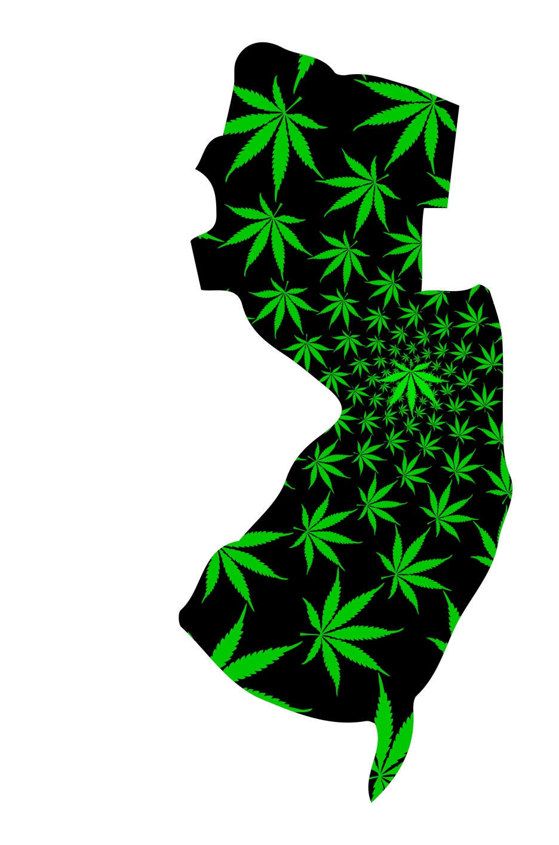
State of Getting High in New Jersey
Carrie ward, earp cohn
New jersey | Philadelphia

Slide 30
Timeline
February 22, 2021, New Jersey became the fourteenth state to make cannabis legal
December 2021 – applications open
March 15, 2022 – prospects can apply – causing some drama due monopolies from existing

Slide 32
Licensing Delays
When process opened, over 500 licensing applications were received within first 4 hours!
Four Alternative Treatment Centers (ATC) — vertically-integrated medical marijuana operations submitted "conversion" applications to sell recreationally
The Cannabis Regulatory Commission’s (CRC) Executive Director Jeff Brown won’t say how long to review the medical marijuana operators' applications
Purchases will initially be made at existing medical marijuana dispensaries, but only after they show they have enough dope for the nearly 100,000 patients in New Jersey

Slide 33
99 Problems and Weed is One
ATCs spent 2021 preparing for retail sales that never came
Some tripled cannabis growing operations and staffing in anticipation of sales beginning in the fourth quarter
Now, vaults stuffed to the gills with harvested cannabis

Slide 34
The applications will take months to result in licensure of those facilities, and then a harvest cycle needs to occur which puts new licensees at least six months away from producing adult-use cannabis.

Slide 35
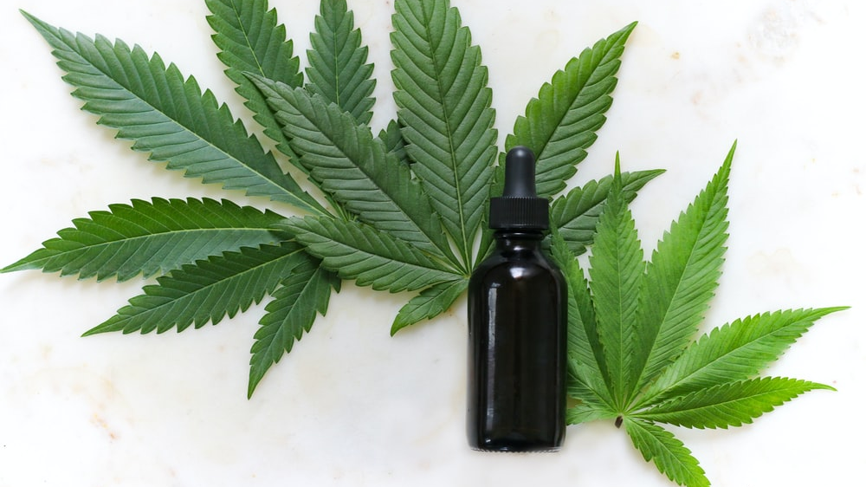
Questions?

Slide 36
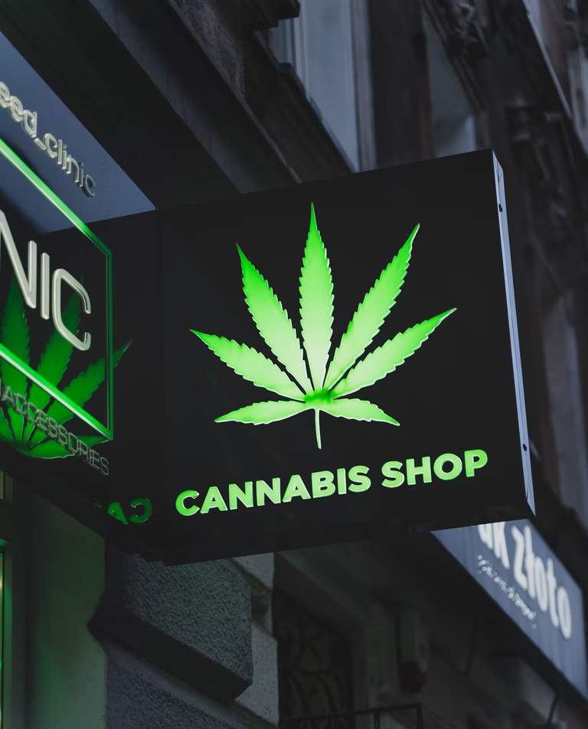
Eric Sleeper
Partner, Barton LLP
esleeper@bartonesq.com
bartonesq.com
Office: 212-687-6262
Cell: 609-203-5788
Carrie Ward
Attorney, Earp Cohn P.C.
cward@earpcohn.com
earpcohn.com
Office: 856-354-7700
Alexandra Becker
Partner, Nolan Heller Kauffman LLP
abecker@nhkllp.com
nhkllp.com
Office: 518-449-3300
Michelle Mabugat
Counsel, Greenberg Glusker Fields Claman & Machtinger LLP
mmabugat@greenbergglusker.com
greenbergglusker.com
Office: 310-785-6845

